Slide 1
Stock Price Prediction System
Group – 10
Section – B1
Rolls: 1505076
1505080
1505089

Slide 2
Entity Relationship Diagram

Slide 3
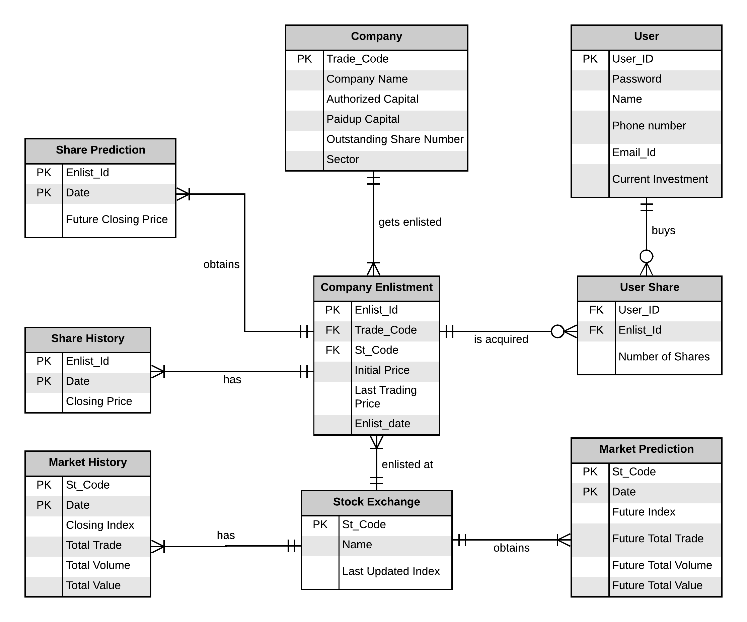

Slide 4
Class Diagram : Predictor Sub-system

Slide 5
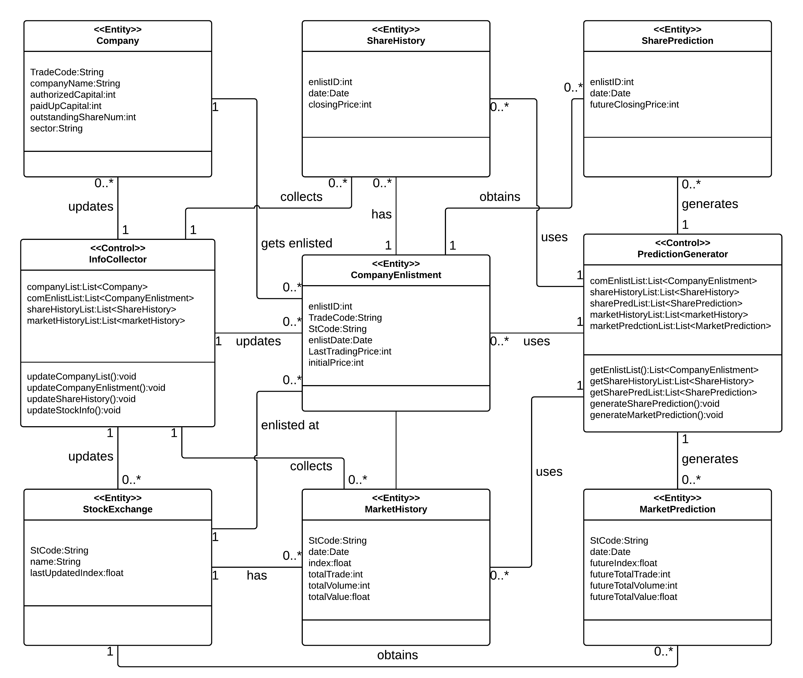
Predictor Sub-System

Slide 6
Class Diagram : Prediction Viewer Sub-system

Slide 7
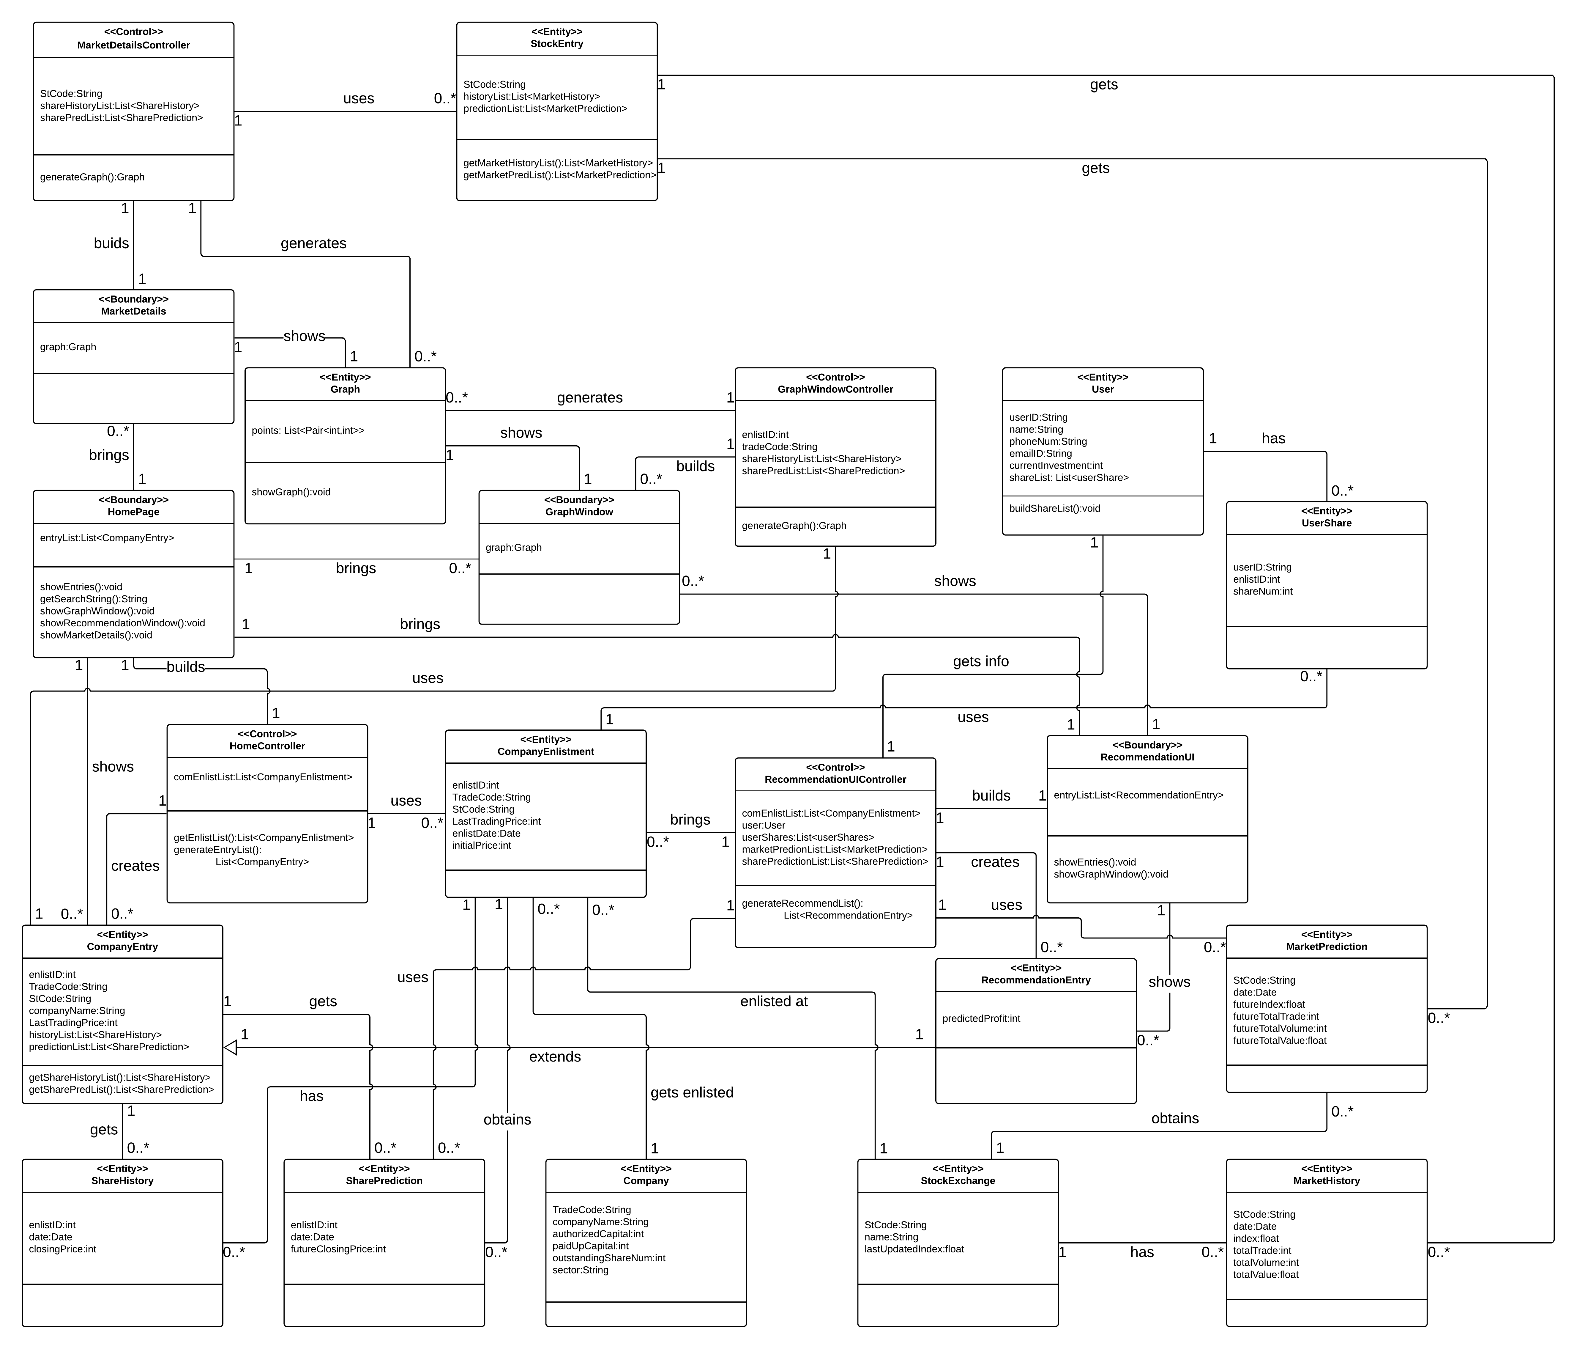
Prediction Viewer Sub-System

Slide 8
Class Diagram : Home Module

Slide 9
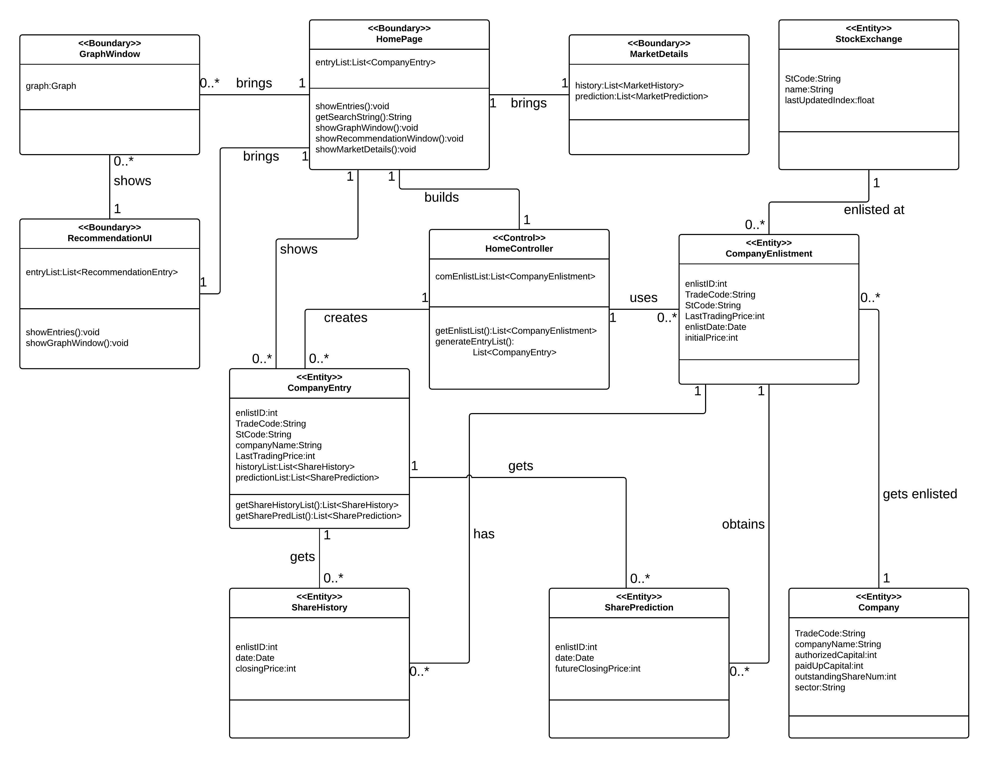
Prediction Viewer Sub-System

Slide 10
Class Diagram : Graph Module

Slide 11
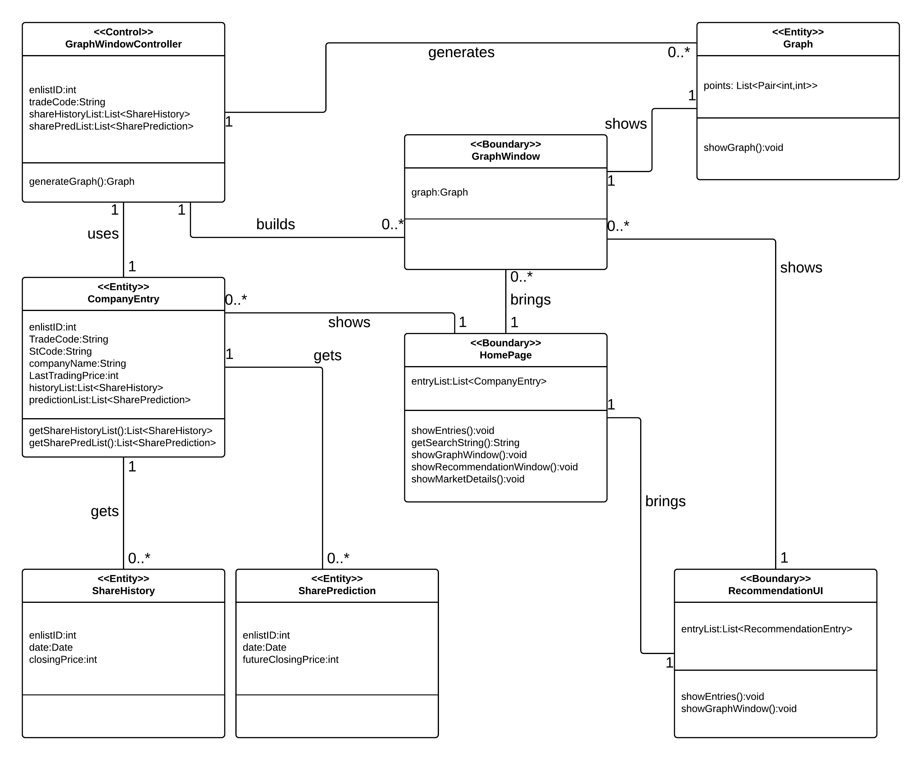
Prediction Viewer Sub-System

Slide 12
Class Diagram : Recommender Module

Slide 13
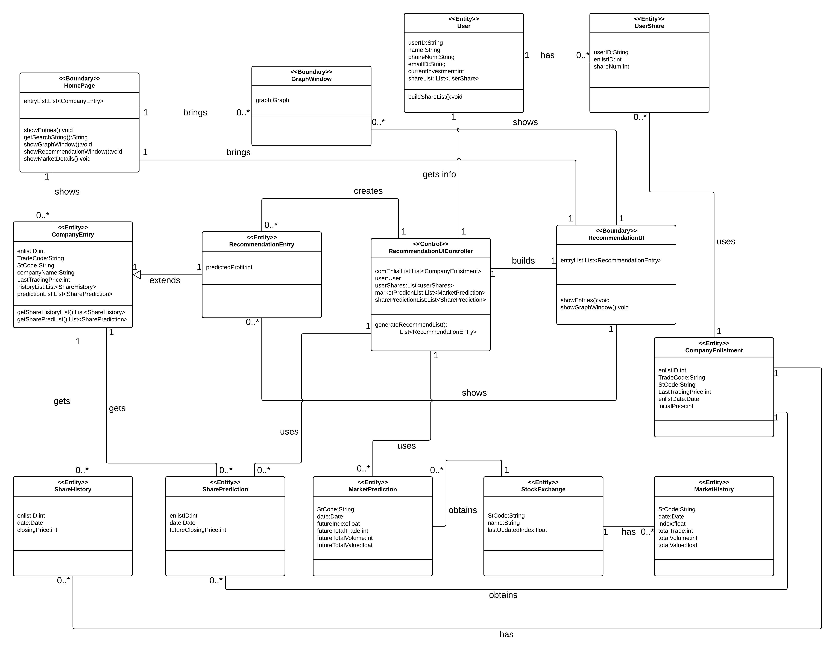
Prediction Viewer Sub-System

Slide 14
Class Diagram : Market Details Module

Slide 15
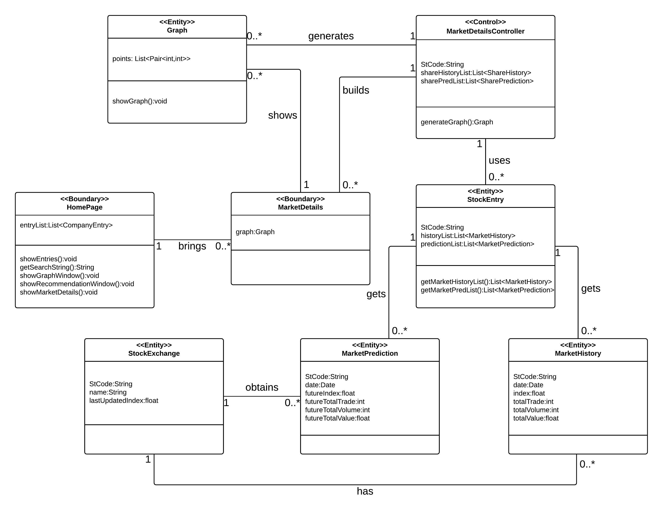
Prediction Viewer Sub-System

Slide 16
Thanks!
Any questions?

